Slide 1

RPA for easy apply in LinkedIn
PRESENTED BY:
ADARSH KUMBAR
DANESH NAIK
SAHIL FANIBAND

Slide 2

Problem
The current process of applying for jobs on LinkedIn is manual and time-consuming. Candidates must manually search for jobs, create a new application for each job, and enter their resume and other information. This process can be tedious and error-prone.
For example, a candidate might spend hours searching for jobs that match their criteria, only to find that many of the jobs are no longer available. They might also make mistakes when entering their resume information, which could lead to their application being rejected.
Here are some specific examples of the problems with the current process of applying for jobs on LinkedIn:
Time-consuming
Error-prone: This can lead to mistakes, such as typos or incorrect information.
Inefficient: This is because candidates must repeat the same steps over and over again for each job that they apply for.

Slide 3

SOLUTION
The RPA project will automate the process of applying for jobs on LinkedIn.
The RPA bot will search for jobs that match the candidate's criteria, create a new application for each job, and enter the candidate's resume and other information.
This will save candidates time and effort, and it will help to ensure that their applications are accurate and complete.
The RPA bot will be able to automate the entire process of applying for jobs on LinkedIn, from searching for jobs to tracking the status of applications. This will save candidates time and effort, and it will help to ensure that their applications are accurate and complete.

Slide 4

Benefits
Save time and effort: The RPA bot will automate the process of applying for jobs, freeing up candidates to focus on other tasks.
Improve accuracy: The RPA bot will ensure that applications are accurate and complete, reducing the risk of errors.
Increased chances of getting hired: RPA bots can apply for jobs faster than humans, giving candidates a better chance of being seen by hiring managers.
The RPA bot will reduce the risk of errors in job applications.

Slide 5
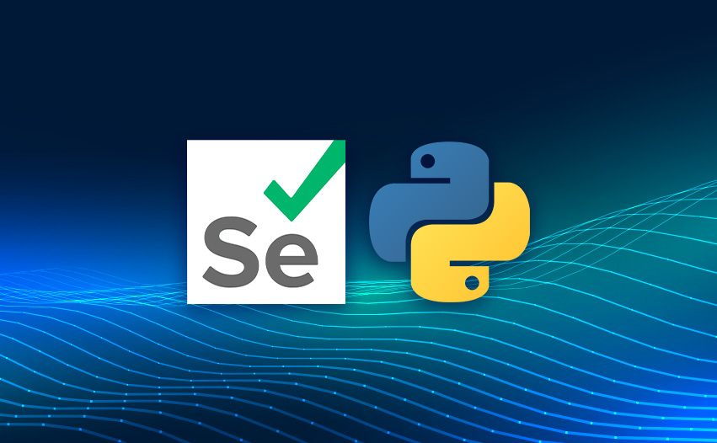
Technical Details
Developed using the following technologies:
Programming language: Python
Web automation framework: Selenium
LinkedIn Easy Apply: LinkedIn feature that allows candidates to apply for jobs directly from their LinkedIn profiles.
Selenium: Selenium is a web automation framework that allows RPA bots to interact with websites. It is open-source and widely used, and it has a large library of pre-written code that can be used to automate common tasks.

Slide 6
Testing and Deployment
Unit testing: used to test individual units of code.
Integration testing: used to test how different units of code interact with each other.
User acceptance testing: performed by users to ensure that the RPA bot meets their needs. Performed by a representative of the target audience.
Additional technical details about the project:
The RPA bot will be hosted on a cloud platform.
It will be scheduled to run on a regular basis.
It will be monitored for performance and errors.

Slide 7
Conclusion
Improve accuracy
Time and effort
Automate the process
The RPA project will save candidates time and effort by automating the job application process.
It will improve accuracy by ensuring that applications are accurate and complete.
Increase chances of getting hired by allowing candidates to apply for more jobs faster.
This project will be developed using Python, Selenium, and LinkedIn Easy Apply.
The RPA bot will be tested and deployed in a production environment.

